Slide 1

ECTE 250
Engineering Design and Management 2
Made by:
Riyadh
Savio
Edwin
Sachin
Knowledge speaks, but wisdom listens….
Jimi Hendrix
Group B

Slide 2
Table of Contents:
1.Introduction.
2. First Idea
2.1. Flow Chart 1.
2.2. State Machine 1.
3. Second Idea.
3.1. Flow Chart 2.
3.2. State Machine 2.
4. Benefits of Our Proposals.
5. Equipment.
6. Market Impact.
7. Conclusion.
8. Future Design Changes.

Slide 3

♦ Introduction:
▪ The first four phases of a product design are:
1- Detailed Design.
2- Simulation.
3- Breadboard prototype.
4- Perforboard prototype.
▪ Why should we save energy
▪ From engineering perspective, what can we do to reduce the energy wasted
▪ What is internet of things

Slide 4
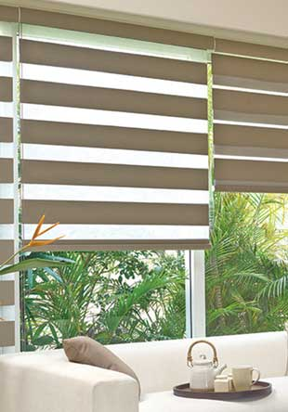
♦ First Idea:
▪ A system that reduces waste of electricity.
▪ Blinds will open automatically during the day if there is sunlight.
▪ Light bulb will turn on if there is no enough light inside the room.
▪ Blinds and the bulb keep on switching and working, respectively.

Slide 5
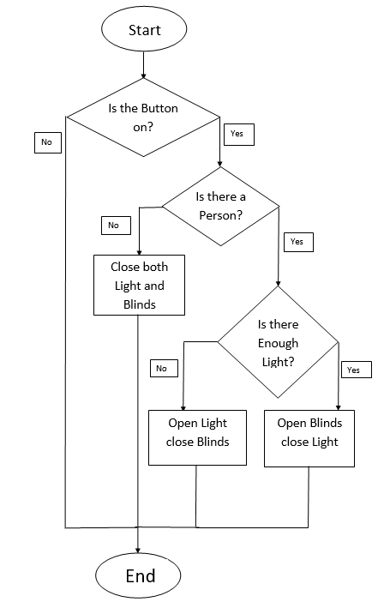
♦ Flow Chart 1:

Slide 6
0XX
111
0XX
None
XX
Open Blinds Close Light 01
111
0XX
Input Order: Switch-Motion-Light.
111
0XX
10X
Output Order: Light-Blinds.
111
110
10X
110
Close Both
00
Open
Light
Close Blinds
10
110
10X
10X
110

Slide 7
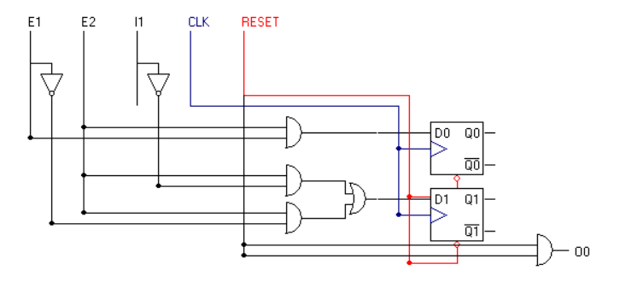
▪ Inputs:
Button=I1.
Motion sensor=E1.
Light intensity=E2.

Slide 8

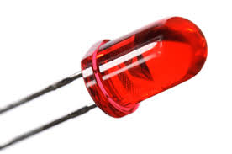
♦ Second Idea:
▪ A system that reduces the waste of water.
▪ The water would pass only if it is warm.
▪ The system works only if the room is bright.
▪ A red LED indictor will turn on if there is enough warm water stored.

Slide 9
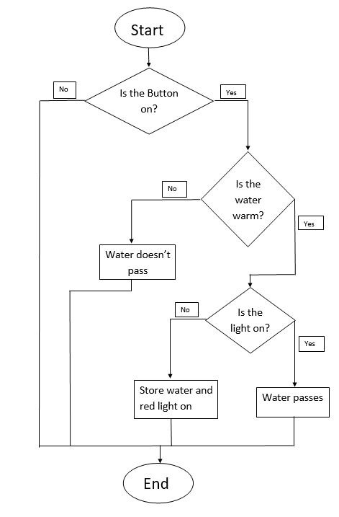
♦ Flow Chart 2:

Slide 10
0XX/100
0XX/100
111
None
00
Water Pass
10
111
0XX/100
Input Order: Button-Temperature-Light.
111
0XX/
100
110
111
101
101
Output Order: Water flow-Red Led.
110
Store Water
01
Water No Pass
00
101
110
110
101

Slide 11
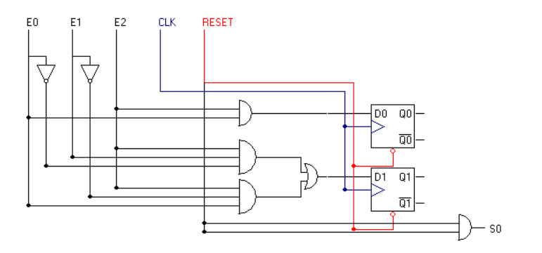
▪ Inputs:
Button=E0.
Water temperature=E1.
Light sensor=E2.

Slide 12
♦ Benefits of Our Proposals:
Proposal one
Proposal Two
● Conservation of Electrical energy.
● An automatic system that open blinds and close light at sun presence.
● Light turns off if no person is inside the room.
● Manual adjustment when the button is off.
● Reduce of water waste.
● Red LED will inform if there is enough worm water to be used.
● The system will be offline if the room is dark.
● Convenient to use in showers.

Slide 13
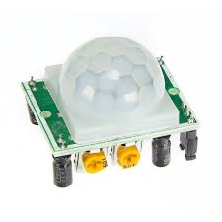
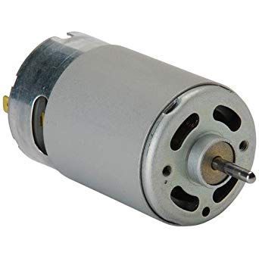
♦ Equipment for Proposal 1:
Part Name | Quantity | Price (AED) Each
Button/Switch | 1 | 5
DC motor | 1 | 25
LED | 4 | 1.5
PIR sensor | 2 | 10
74HC74 (Dual D type flip flops) | 2 | 4
74LS08 (Quad 2-input AND gate) | 4 | 4
74HC02 (Quad 2-input NOR gate) | 1 | 4
▪ These parts could be incomplete. As we might require a new part.
▪ 555 Timer circuit will also be used.

Slide 14
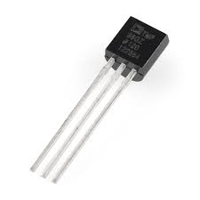
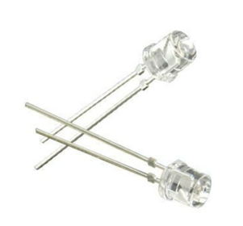
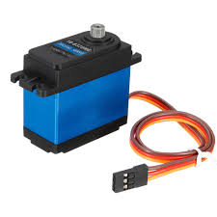
♦ Equipment for Proposal 2:
Part Name | Quantity | Price (AED) Each
Button/Switch | 1 | 5
Servo motor | 1 | 8
LED | 4 | 1.5
Photo resistor | 4 | 1
Temperature Sensor | 1 | 6.5
74HC74 (Dual D type flip flops) | 2 | 4
74HC02 (Quad 2-input NOR gate) | 2 | 4
74LS08 (Quad 2-input AND gate) | 8 | 4

Slide 15
♦ Labour Cost:
▪ Labour cost is 300AED/hour. And 400AED/hour for consultation from Lab instructor.
▪ The estimated working hours on the technical parts as follows:
Technical work | Hours | Price (AED)
State Machine subsystem design | 14 | 4200
State machine integration design | 18 | 5400
Arduino subsystem design | 10 | 3000
Sensing subsystem design | 18 | 5400
Auxiliary subsystem design | 12 | 3600
▪ The total price is: 21,600 AED.

Slide 16
♦ Market Prospects:
▪ To whom these products appeal to
▪ The 1st design, which involves the integration of light sensors and blinds, which help reduce the consumption of electricity.
▪ The target market, is companies with large office spaces , real estate projects to help design and integrate the system.
▪ The second design: Water heating system.
▪ One way of approaching is to design, manufacture and market the product, we can also patent the design and sell it to other companies, who might be interested in gaining a better edge from its competitors.

Slide 17
♦ Conclusion:
▪ The designed product in mind is a Moore Machine.
▪ Both designs have Analog sensors and uses an Analog to Digital convertor.
▪ The first design involves a DC Permanent Magnet motor, whereas
the second design uses a DC Servo motor.
▪ Each design has one button, primarily used to turn on the device or
vice versa.
▪ Application of IOT (Internet of Things).
▪ The designs includes a two-line LCD display.

Slide 18
♦ Future Design Changes:
▪ The light sensor from the water heating system may be replaced with a sensor that detects whether the tank is full or empty.
▪ Any flaws seen in the design ,or changes needed to be made (as a result of complexity, or for any reason that my hold valid and justified), by mentors or fellow competitors, will be investigated and worked upon.

Slide 19
Thank you!
Please ask questions if you have any concern.

